Slide 1


GIT basics and workflows

Slide 2
Version Control System(VCS)
A version control system (also known as a Revision Control System) is a repository of files, often the files for the source code of computer programs, with monitored access. Every change made to the source is tracked, along with who made the change, why they made it, and references to problems fixed, or enhancements introduced by the change.
Benefits of using VCS:
Version Tracking.
Coordinating Teams.
Due Diligence.

Slide 3
GIT
Git is a widely used source code management system for managing a repository. It is a distributed revision control system with an emphasis on speed and data integrity.Git was initially designed and developed in 2005 by Linux kernel developers(Linus Torvalds and team).
Few Git Hosting services are:
GitHub
GitLab
Bitbucket
CloudForge
BeanStalk

Slide 4
Basic Git Flow
1st time user command sequence.
$ git init //In kellton tech, done by IT team.
$ git clone 'url'
$ git checkout -b MyNewBranch
$git status
$ git add *
$git commit -m “message”
$git push origin MyNewBranch

Slide 5
Basic Git Flow
User command sequence for an existing repo.
$ git clone 'url'
$ git checkout MyNewBranch
$git status
$ git add *
$git pull
$git commit -m “message”
$git push origin MyNewBranch

Slide 6
Few GUI for Git
GitHub forMac/Windows
SourceTree.

Slide 7
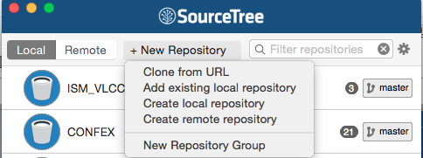
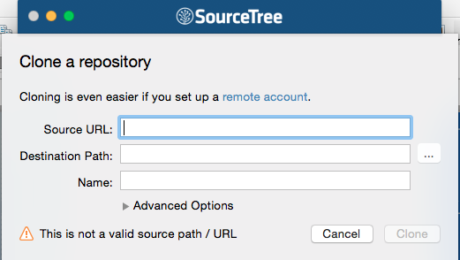
SourceTree- Clone a repo

Slide 8
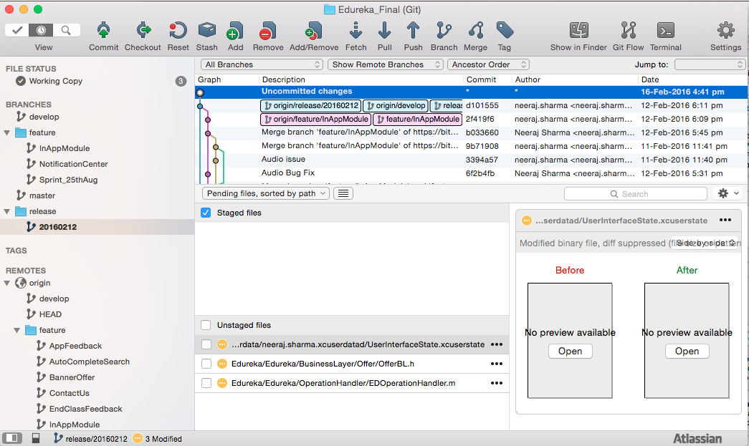
Source Tree- Basic

Slide 9
Basic GIT Commands
CONFIGURE TOOLING
Configure user information for all local repositories
$ git config --global user.name "[name]"
Sets the name you want attached to your commit transactions
$ git config --global user.email "[email address]"
Sets the email you want attached to your commit transactions

Slide 10
Basic GIT Commands
CREATE REPOSITORIES
Start a new repository or obtain one from an existing URL
$ git init [project-name]
Creates a new local repository with the specified name
$ git clone [url]
Downloads a project and its entire version history

Slide 11
Basic GIT Commands
MAKE CHANGES
Review edits and craft a commit transaction
$ git status
Lists all new or modified files to be committed
$ git add [file]
Snapshots the file in preparation for versioning
$ git reset [file]
Unstages the file, but preserve its contents
$ git commit -m "[descriptive message]"
Records file snapshots permanently in version history

Slide 12
Basic GIT Commands
GROUP CHANGES
Name a series of commits and combine completed efforts
$ git branch
Lists all local branches in the current repository
$ git branch [branch-name]
Creates a new branch
$ git checkout [branch-name]
Switches to the specified branch and updates the working directory
$ git merge [branch]
Combines the specified branch’s history into the current branch
$ git branch -d [branch-name]
Deletes the specified branch

Slide 13
Basic GIT Commands
REVIEW HISTORY
Browse and inspect the evolution of project files
$ git log
Lists version history for the current branch
$ git log --follow [file]
Lists version history for a file, including renames
$ git diff [first-branch]...[second-branch]
Shows content differences between two branches
$ git show [commit]
Outputs metadata and content changes of the specified commit

Slide 14
Basic GIT Commands
REDO COMMITS
Erase mistakes and craft replacement history
$ git reset [commit]
Undoes all commits after [commit], preserving changes locally
$ git reset --hard [commit]
Discards all history and changes back to the specified commit

Slide 15
Basic GIT Commands
SAVE FRAGMENTS
Shelve and restore incomplete changes
$ git stash
Temporarily stores all modified tracked files.
$ git stash apply
Apply stashed files.
$ git stash list
Lists all stashed changesets
$ git stash drop
Discards the most recently stashed changeset

Slide 16
Basic GIT Commands
SYNCHRONIZE CHANGES
Register a repository bookmark and exchange version history
$ git push [alias] [branch]
Uploads all local branch commits to GitHub
$ git pull
Downloads bookmark history and incorporates changes

Slide 17
GitFlow Workflow

Slide 18
Introduction
git-flow are a set of git extensions to provide high-level repository operations.
Git flow provides excellent command line help and output.
The OSX/Windows Client Sourcetree is an excellent git gui and provides git-flow support

Slide 19
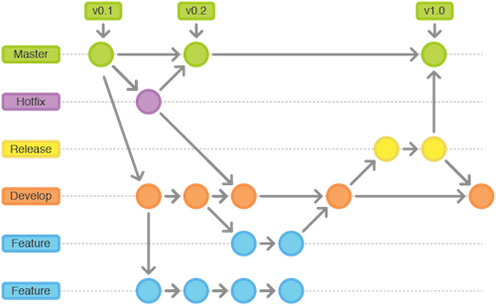
Workflow

Slide 20
Setup.
You need a working git installation as prerequisite.
For detailed git flow installation instructions please visit the https://github.com/nvie/gitflow/wiki/Windows
OR
you also use SourceTree(Git GUI component).

Slide 21
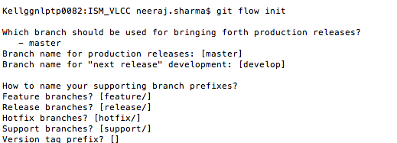
Initialize
Start using git-flow by initializing it inside an existing git repository:
$ git flow init
You'll have to answer a few questions regarding the naming conventions for your branches.
It's recommended to use the default values.

Slide 22
Feature
Start a new feature
Start developing a new feature with
$ git flow feature start MYFEATURE
This action creates a new feature branch based on 'develop' and switches to it
Finish up a feature
This action performs the following
$ git flow feature finish MYFEATURE
Merged MYFEATURE into 'develop'
Removes the feature branch
Switches back to 'develop' branch

Slide 23
Feature
Publish a feature.
Publish a feature to the remote server so it can be used by other users.
$ git flow feature publish MYFEATURE
Getting a published feature
Get a feature published by another user.
$ git flow feature pull origin MYFEATURE

Slide 24
Release
Start a release
It creates a release branch created from the 'develop' branch.
$ git flow release start RELEASE [BASE]
You can optionally supply a [BASE] commit sha-1 hash to start the release from. The commit must be on the 'develop' branch.
Publish a release
It's wise to publish the release branch after creating it to allow release commits by other developers. Do it similar to feature publishing with the command:
$ git flow release publish RELEASE

Slide 25
Release
Finish up a release
Finishing a release is one of the big steps in git branching. It performs several actions:
Merges the release branch back into 'master'
Tags the release with its name
Back-merges the release into 'develop'
Removes the release branch
$ git flow release finish RELEASE
Don't forget to push your tags with
$ git push --tags

Slide 26
Hotfixes
Hotfixes arise from the necessity to act immediately upon an undesired state of a live production version.
Hotfix start
$ git flow hotfix start VERSION [BASENAME]
The version argument hereby marks the new hotfix release name. Optionally you can specify a basename to start from.
Finish a hotfix
By finishing a hotfix it gets merged back into develop and master. Additionally the master merge is tagged with the hotfix version.
$ git flow hotfix finish VERSION

Slide 27
Q & A

Slide 28
THANK YOU

